Slide 1

Course Code: CSE3002
Course Name: Artificial Intelligence
Faculty Name:
Dr. D Ramkumar
AP/SCOPE
VIT-AP

Slide 2
Module-4
Module 4: | Knowledge Inference | 8 Hours
Knowledge representation -Production based system, Frame based system. Inference - Backward chaining, Forward chaining, Rule value approach, Fuzzy reasoning - Certainty factors, Bayesian Theory-Bayesian Network-Dempster - Shafer theory.

Slide 3
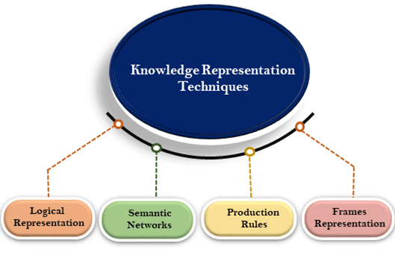
Techniques of knowledge representation

Slide 4
Knowledge representation -Production based system, Frame based system.
Production System

Slide 5


Production system
Production system (or production rule system) was proposed by Allen Newell in 1973.
A production system typically contains three components
Inference engine.
Knowledge base (Long-term memory), and
Working memory (Short-term
memory).
Inference Engine
Knowledge base
Working memory
The idea of separating the knowledge and the inference engine is useful for designing different expert systems.

Slide 7
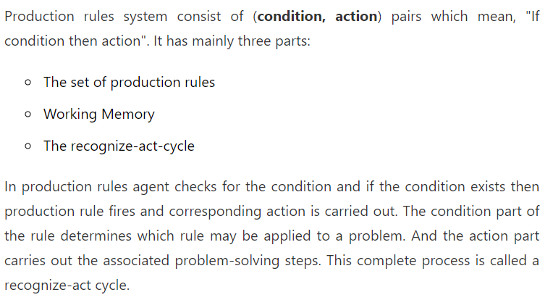
Production Rules

Slide 8
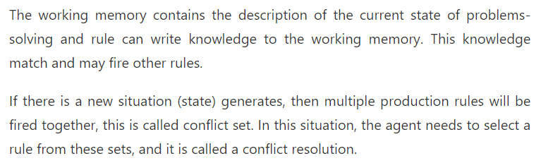

Slide 9
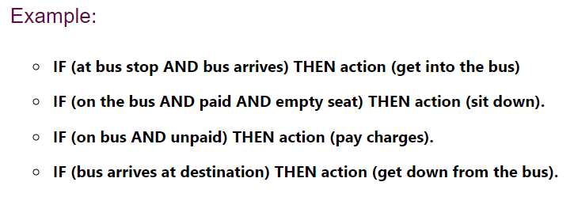

Slide 10


Working memory
The working memory is also called short-term memory.
It contains the observed data for making decisions, and the intermediate results (derived data) produced by the inference engine.
Example
f1: x has black strings
f2: x has white body color
f3: x has hoofs
f4: x has odd number of toes
f5: x drink milk
A child is often considered as “clever” if he/she has a
good short-term memory capability.

Slide 11
Definition of knowledge
In a production system, a rule is usually defined as follows:
Rule name
If (condition)
Then (Action)
Example
U3 | X is an ungulate AND x ruminates | Add “x is an even-toed ungulate”
Examples of actions: add a new datum, delete an old datum, replace an existing datum, etc.

Slide 12
What is a Production System in Artificial Intelligence?
A production system is a type of cognitive architecture for implementing search algorithms and simulating human problem-solving abilities. This problem-solving knowledge is stored in the system in the form of products, which are little quanta.

Slide 13
A woman was found dead at the bottom of a 5-story building. There is a suicide note which says she committed suicide by jumping from a window on one of the floors of the building. When the detective arrived, he went to the first floor, opened the window and tossed a coin towards the floor. He repeats this on all the floors of the building.
He comes down and tells the police that the woman was murdered. How does the detective know?
The windows were all closed. He opened the windows to toss the coin.

Slide 14
Inference engine:
The inference engine is the component of the intelligent system in artificial intelligence, which applies logical rules to the knowledge base to infer new information from known facts. The first inference engine was part of the expert system. Inference engine commonly proceeds in two modes, which are:
Forward chaining
Backward chaining

Slide 15
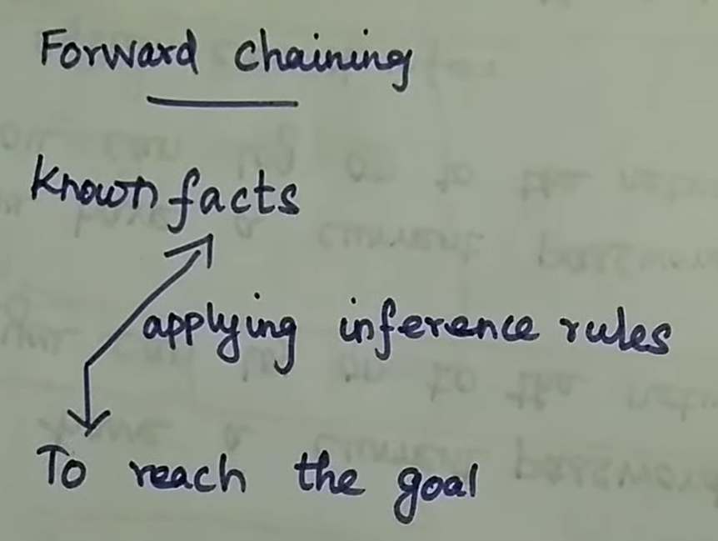
Forward Chaining

Slide 16
Forward Chaining
Forward chaining is also known as a forward deduction or forward reasoning method when using an inference engine.
Forward chaining is a form of reasoning which start with atomic sentences in the knowledge base and applies inference rules (Generalized Modus Ponens) in the forward direction to extract more data until a goal is reached.
The Forward-chaining algorithm starts from known facts, triggers all rules whose premises are satisfied, and add their conclusion to the known facts.

Slide 17
Forward Chaining
This process repeats until the problem is solved.
Properties of Forward-Chaining:
It is a down-up approach, as it moves from bottom to top.
It is a process of making a conclusion based on known facts or data, by starting from the initial state and reaches the goal state.
Forward-chaining approach is also called as data-driven as we reach to the goal using available data.
Forward -chaining approach is commonly used in the expert system, such as DENDRAL, CLIPS, business, and production rule systems.
https://www.javatpoint.com/forward-chaining-and-backward-chaining-in-ai

Slide 18
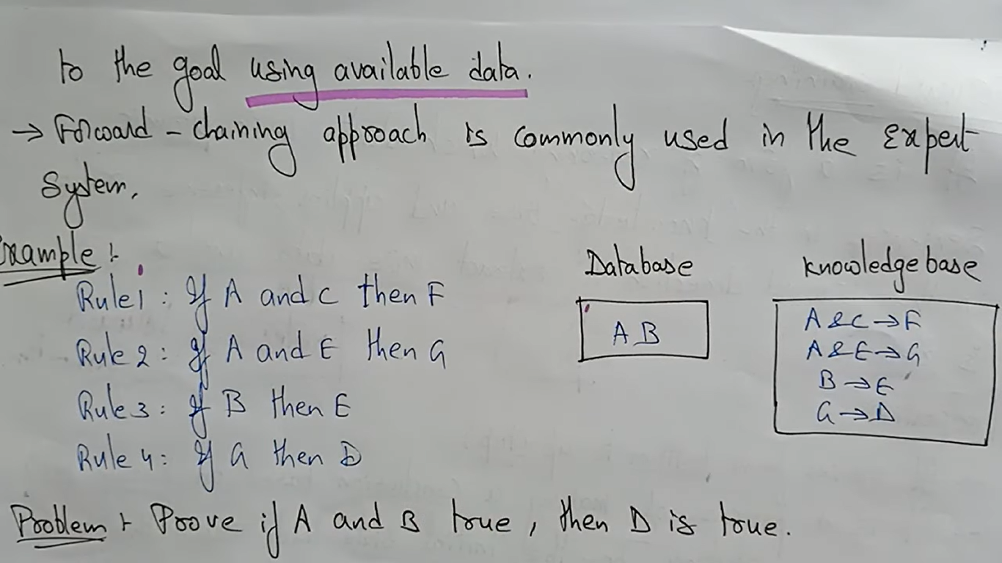

Slide 19
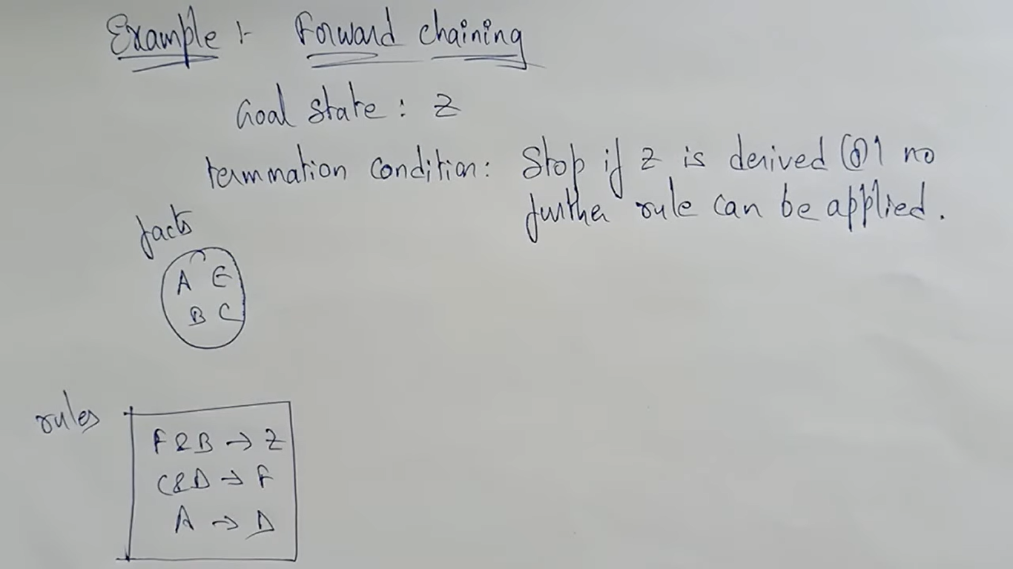

Slide 20
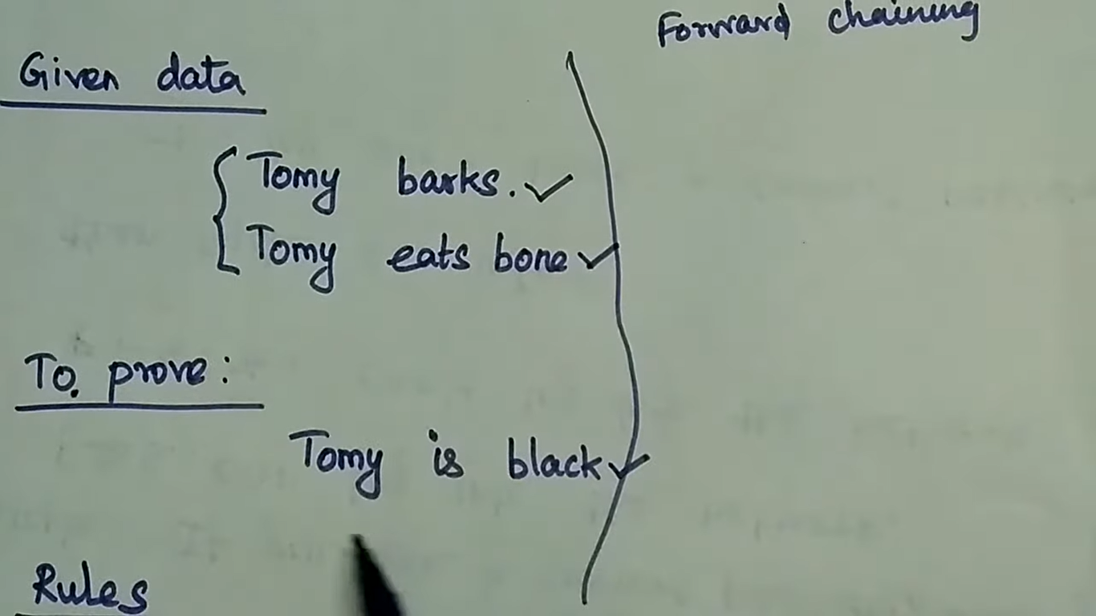
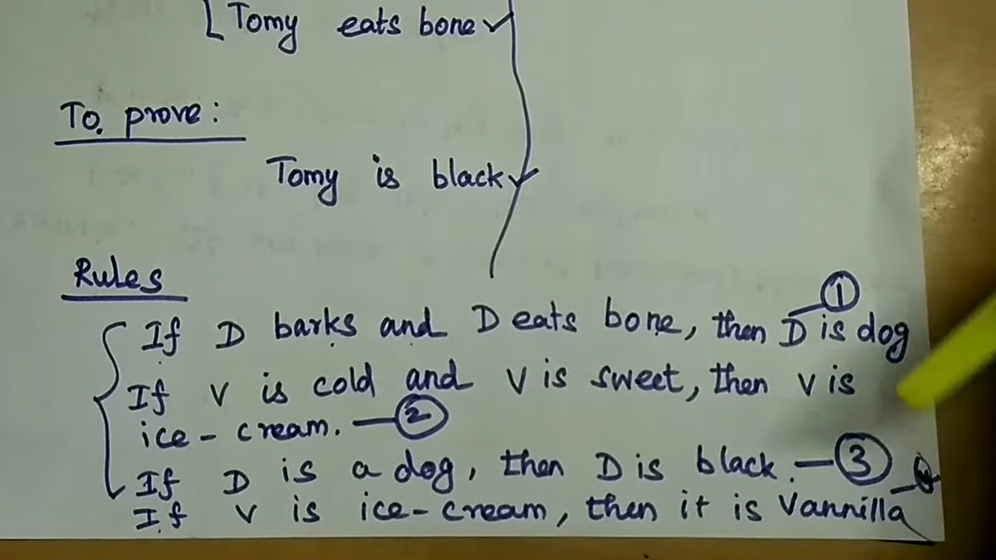

Slide 21
Example
"As per the law, it is a crime for an American to sell weapons to hostile nations. Country A, an enemy of America, has some missiles, and all the missiles were sold to it by Robert, who is an American citizen.“
Prove that Robert is a Criminal
Convert Facts into First Order Definite Clauses
It is a crime for an American to sell weapons to hostile nations.
(Let's say p, q, and r are variables)
American (p) ∧ weapon(q) ∧ hostile(r) ∧ sells (p, q, r) → Criminal(p) ...(1)

Slide 22
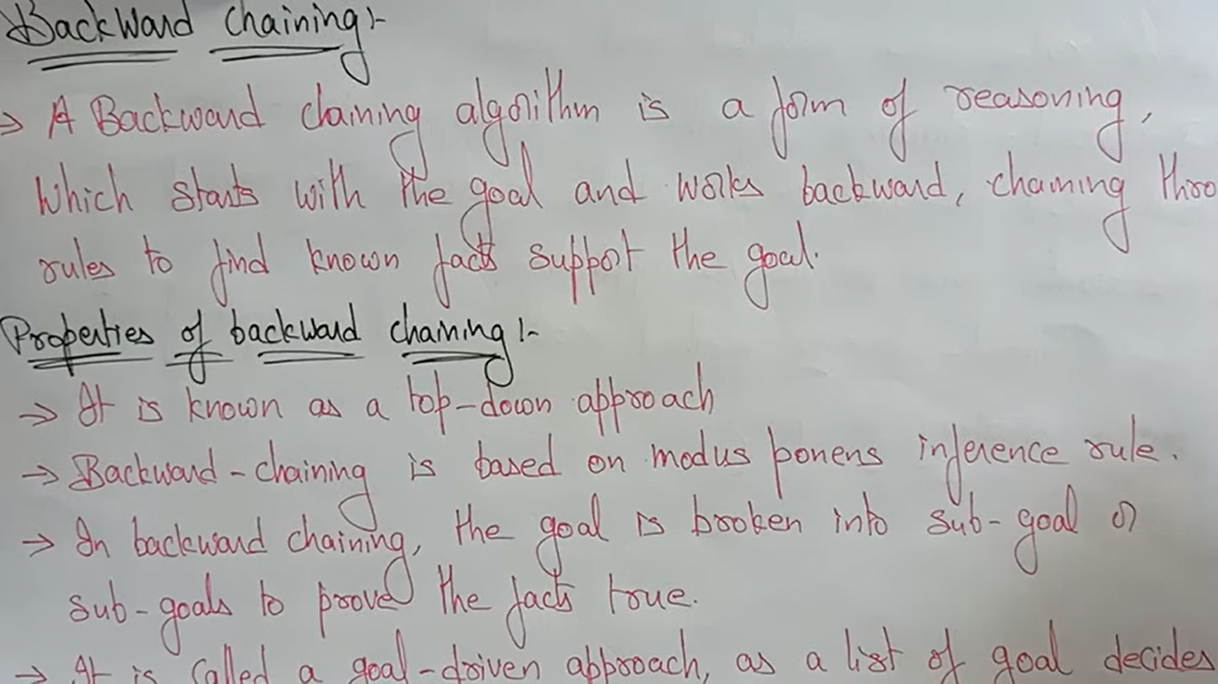
Backward Chaining
https://www.youtube.com/watch?v=nMLUb6E6ZQ0

Slide 23
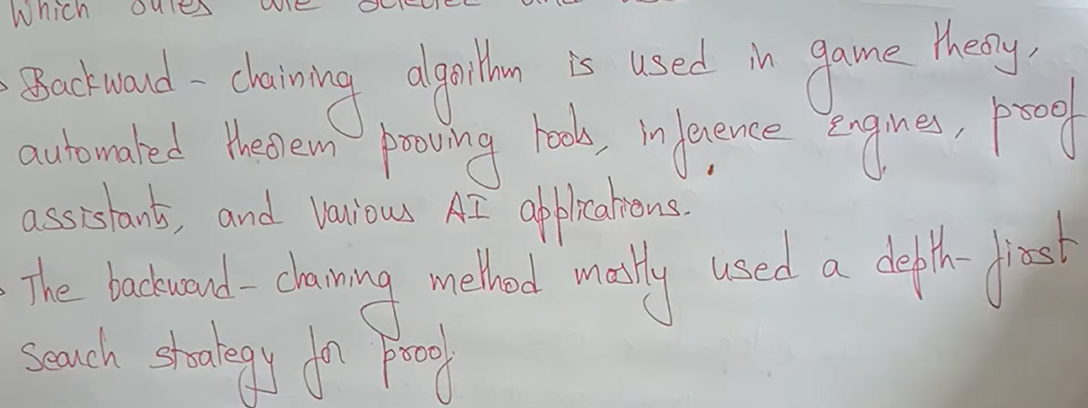

Slide 24
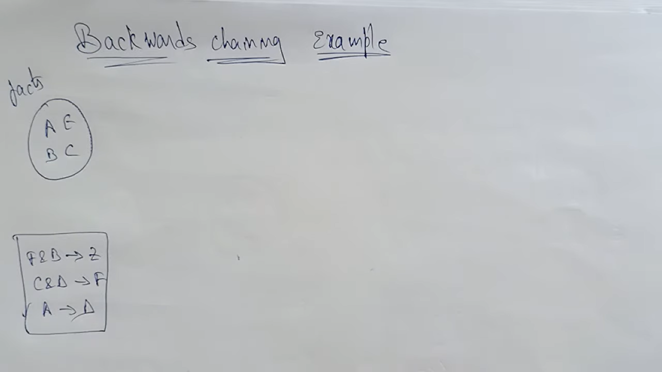

Slide 25
Rule-Base in AI
Rule-based classifiers are just another type of classifier which makes the class decision depending by using various “if..else” rules. These rules are easily interpretable and thus these classifiers are generally used to generate descriptive models. The condition used with “if” is called the antecedent and the predicted class of each rule is called the consequent.
Such approaches hope to build on the success of logical rule-based systems
Rule-based Systems → a logical program that uses pre-defined rules to make deductions and choices to perform automated actions.

Slide 26
Rule-Based Systems
A rule-based system is a system that applies human-made rules to store, sort and manipulate data. In doing so, it mimics human intelligence.
To work, rule-based systems require a set of facts or source of data, and a set of rules for manipulating that data. These rules are sometimes referred to as ‘If Statement’ as they tend to follow the line of ‘IF X happens THEN do Y’.
Its working principle could be summarized as:
First comes the data or new event
Then comes the analysis: the part where the system conditionally processes the data against its rules
Then comes any subsequent automated follow-up actions

Slide 27
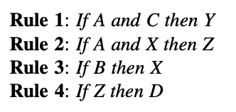
Inference And Rule-Based Systems
A rule-based system consists of if-then rules, a bunch of facts, and an interpreter controlling the application of the rules, given the facts
if x is A then y is B’ and the if-part of the rule ‘x is A’ is called the antecedent or premise, while the then-part of the rule ‘y is B’ is called the consequent or conclusion. There are two broad kinds of inference engines used in rule-based systems: forward chaining and backward chaining systems.
Consider the following rules

Slide 28
Inference And Rule-Based Systems
Prove that D is true, given A and B are true
According to forward chaining, start with Rule 1 and go on downward till a rule that fires is found. Rule 3 is the only one that fires in the first iteration.
After the first iteration, it can be concluded that A, B, and X are true.
The second iteration uses this valuable information.
After the second iteration, Rule 2 fires adding Z is true, which in turn helps Rule 4 to fire, proving that D is true

Slide 29
Inference And Rule-Based Systems
In the backward chaining method, processing starts with the desired goal, and then attempts to find evidence for proving the goal.
Returning to the same example, the task to prove that D is true would be initiated by first finding a rule that proves D.
Rule 4 does so, which also provides a subgoal to prove that Z is true.
Now Rule 2 comes into play, and as it is already known that A is true, the new subgoal is to show that X is true.
Rule 3 provides the next subgoal of proving that B is true.
But that B is true is one of the given assertions.
Therefore, it could be concluded that X is true, which implies that Z is true, which in turn also implies that D is true

Slide 30
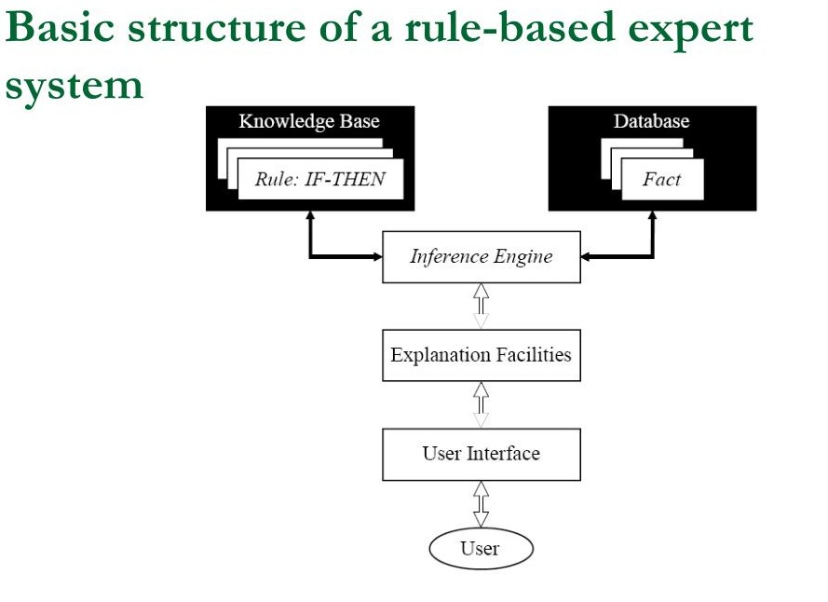

Slide 31
Properties of Rule-base Classifier
Coverage: The percentage of records which satisfy the antecedent conditions of a particular rule.
The rules generated by the rule-based classifiers are generally not mutually exclusive, i.e. many rules can cover the same record.
The rules generated by the rule-based classifiers may not be exhaustive, i.e. there may be some records which are not covered by any of the rules.
The decision boundaries created by them is linear, but these can be much more complex than the decision tree because the many rules are triggered for the same record.

Slide 32
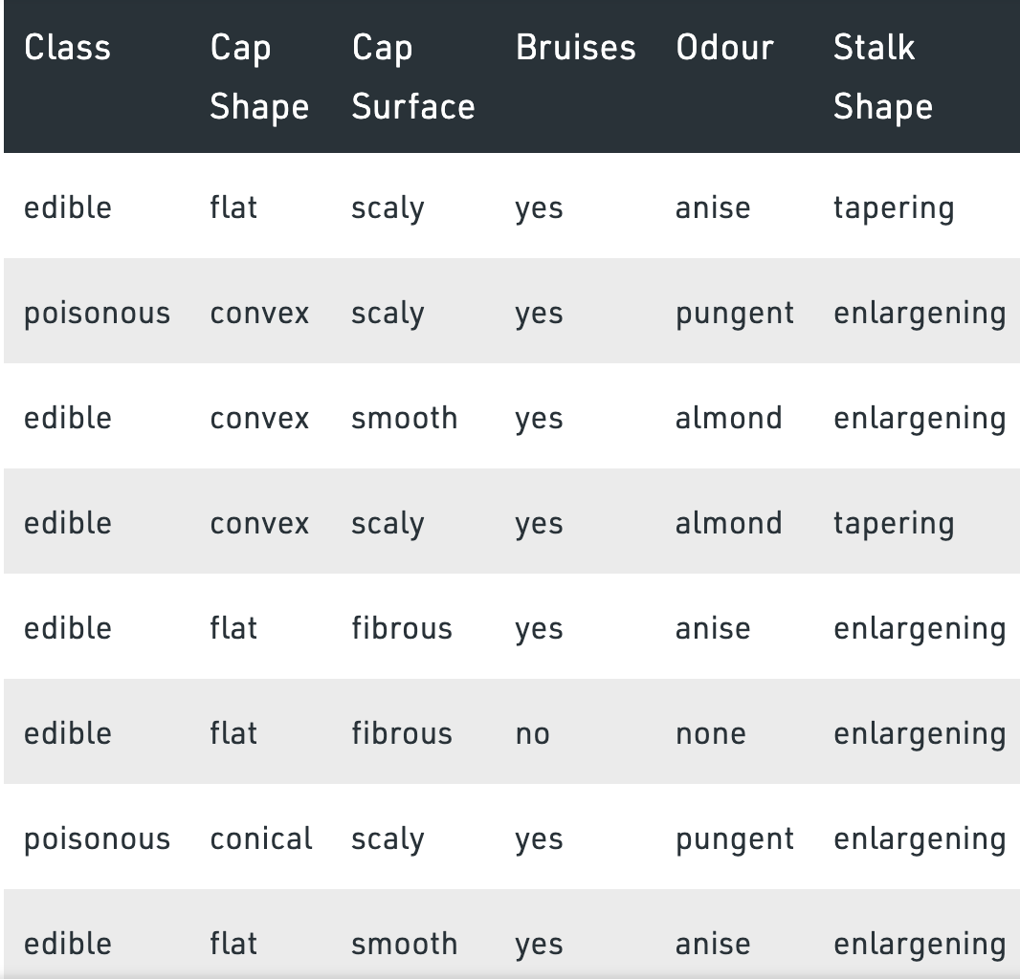
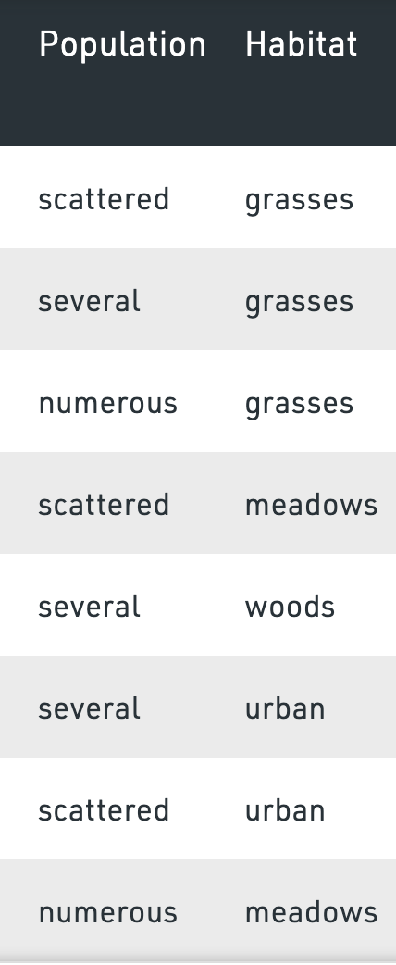

Rule-base to classify mushrooms as edible or poisonous

Slide 33
Properties of Rule-base Classifier
Rules are not mutually exclusive → how would the class be decided in case different rules with different consequent cover the record?
Rules can be ordered, i.e. the class corresponding to the highest priority rule triggered is taken as the final class.
we can assign votes for each class depending on some their weights, i.e. the rules remain unordered.
Odour = pungent and habitat = urban -> Class = poisonous Bruises = yes -> Class = edible :
This rules covers both negative and positive records. The given rules are not mutually exclusive.

Slide 34
Fuzzy Logic

Slide 35
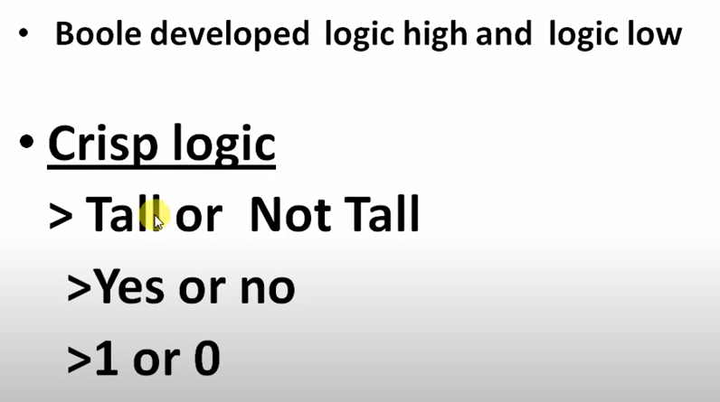
Fuzzy Logic

Slide 36
Fuzzy Logic
The term fuzzy refers to things that are not clear or are vague. In the real world many times we encounter a situation when we can’t determine whether the state is true or false, their fuzzy logic provides very valuable flexibility for reasoning. In this way, we can consider the inaccuracies and uncertainties of any situation.
In the boolean system truth value, 1.0 represents the absolute truth value and 0.0 represents the absolute false value. But in the fuzzy system, there is no logic for the absolute truth and absolute false value. But in fuzzy logic, there is an intermediate value too present which is partially true and partially false.

Slide 37
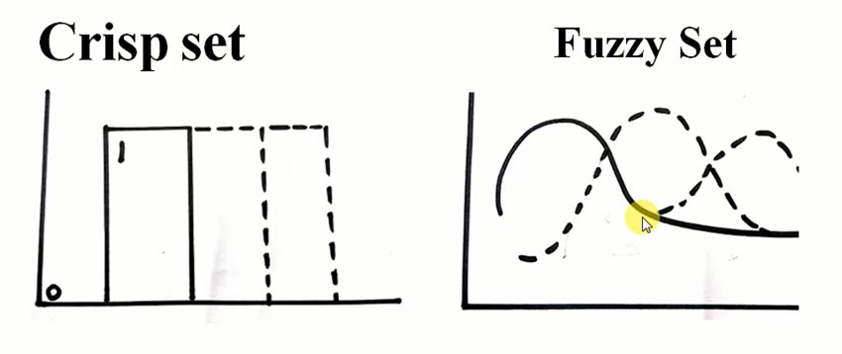

Slide 38
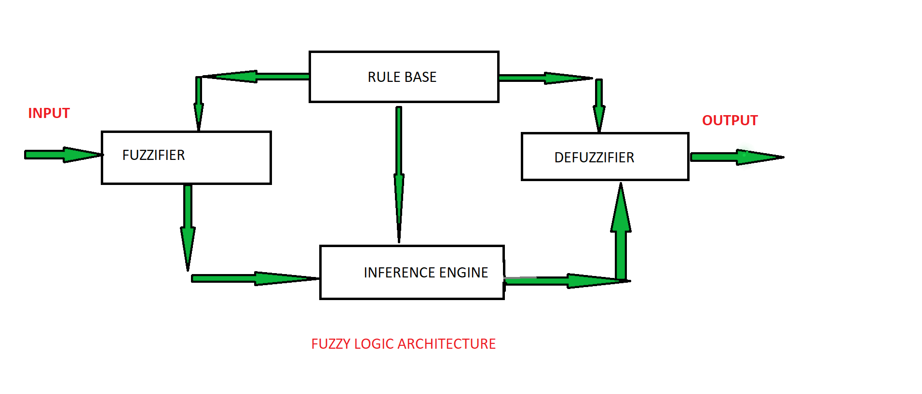
Fuzzy Logic
Its Architecture contains four parts :
RULE BASE: It contains the set of rules and the IF-THEN conditions provided by the experts to govern the decision-making system, on the basis of linguistic information. Recent developments in fuzzy theory offer several effective methods for the design and tuning of fuzzy controllers. Most of these developments reduce the number of fuzzy rules.
FUZZIFICATION: It is used to convert inputs i.e. crisp numbers into fuzzy sets. Crisp inputs are basically the exact inputs measured by sensors and passed into the control system for processing, such as temperature, pressure, rpm’s, etc.
INFERENCE ENGINE: It determines the matching degree of the current fuzzy input with respect to each rule and decides which rules are to be fired according to the input field. Next, the fired rules are combined to form the control actions.
DEFUZZIFICATION: It is used to convert the fuzzy sets obtained by the inference engine into a crisp value. There are several defuzzification methods available and the best-suited one is used with a specific expert system to reduce the error.

Slide 39
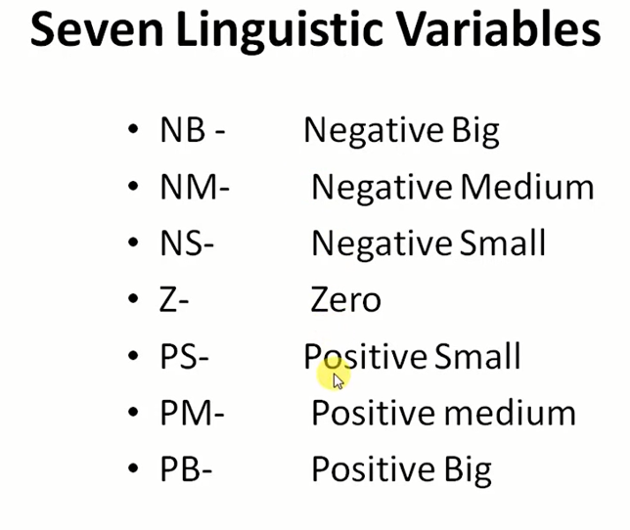

Slide 40
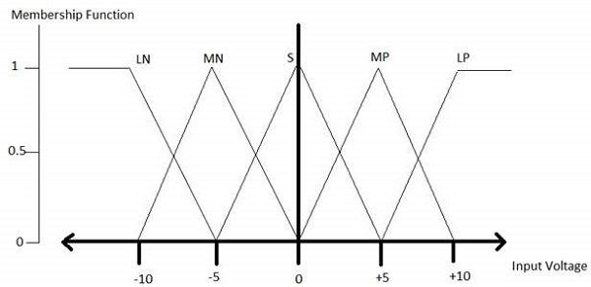
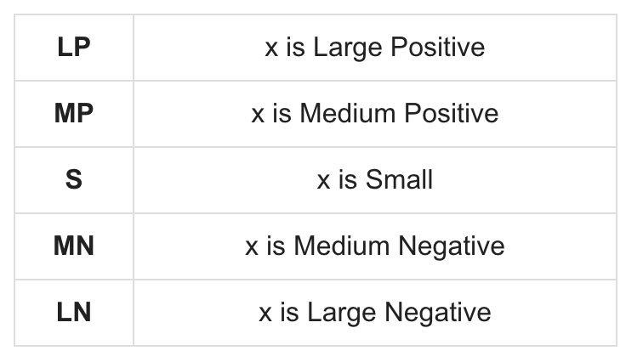
Fuzzy Logic: Membership Function
Membership functions allow you to quantify linguistic term and represent a fuzzy set graphically. A membership function for a fuzzy set A on the universe of discourse X is defined as μ_{A}:X → [0,1].
Here, each element of X is mapped to a value between 0 and 1. It is called membership value or degree of membership. It quantifies the degree of membership of the element in X to the fuzzy set A.
x axis represents the universe of discourse.
y axis represents the degrees of membership in the [0, 1] interval.
There can be multiple membership functions applicable to fuzzify a numerical value. Simple membership functions are used as use of complex functions does not add more precision in the output.
All membership functions for LP, MP, S, MN, and LN are shown as below −

Slide 41
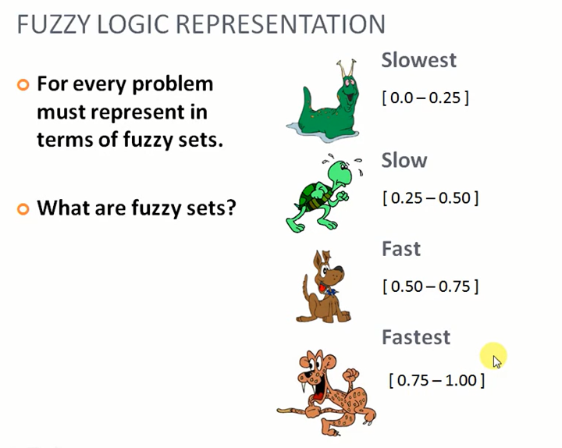

Slide 42
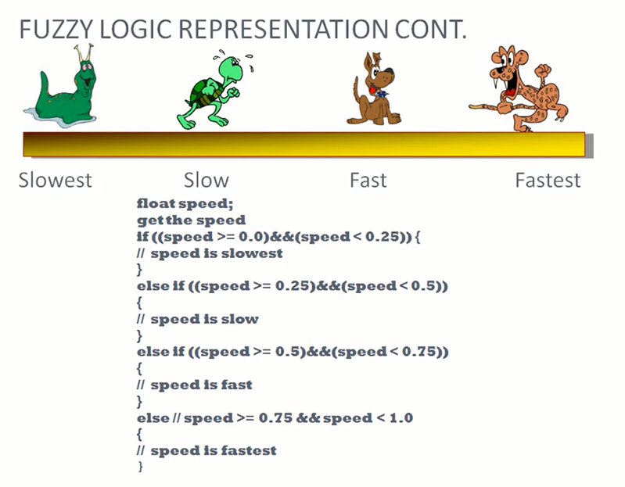

Slide 43
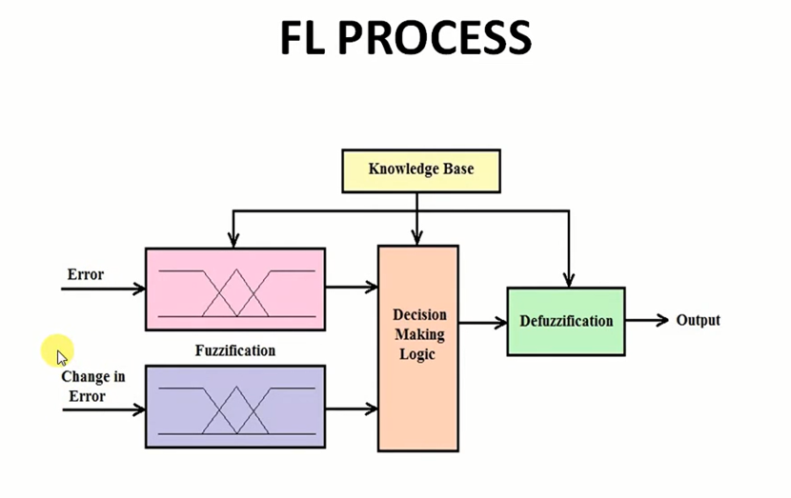

Slide 44
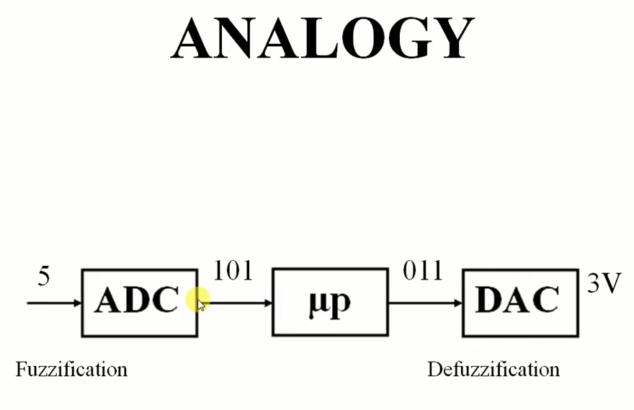

Slide 45
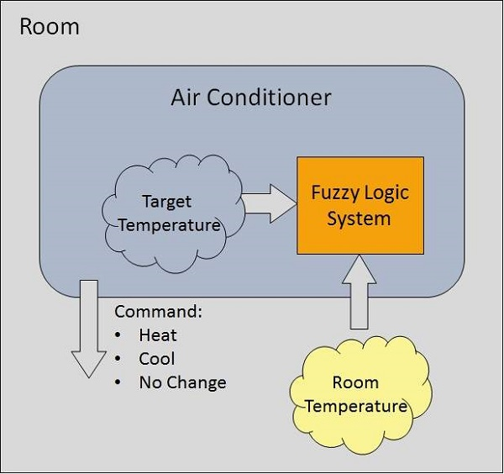
Fuzzy Logic System: Example
Algorithm
Define linguistic Variables and terms (start)
Construct membership functions for them. (start)
Construct knowledge base of rules (start)
Convert crisp data into fuzzy data sets using membership functions. (fuzzification)
Evaluate rules in the rule base. (Inference Engine)
Combine results from each rule. (Inference Engine)
Convert output data into non-fuzzy values. (defuzzification)

Slide 46
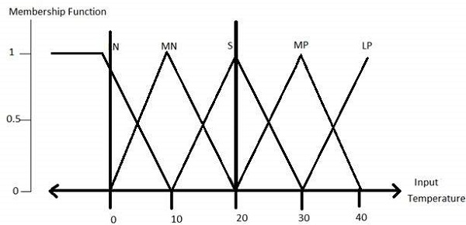
Fuzzy Logic System: Example
Step 1 − Define linguistic variables and terms
Linguistic variables are input and output variables in the form of simple words or sentences. For room temperature, cold, warm, hot, etc., are linguistic terms.
Temperature (t) = {very-cold, cold, warm, very-warm, hot}
Every member of this set is a linguistic term and it can cover some portion of overall temperature values.
Step 2 − Construct membership functions for them

Slide 47
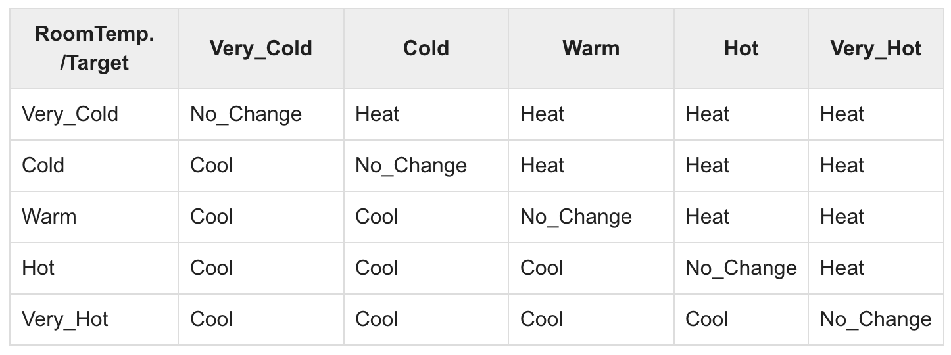
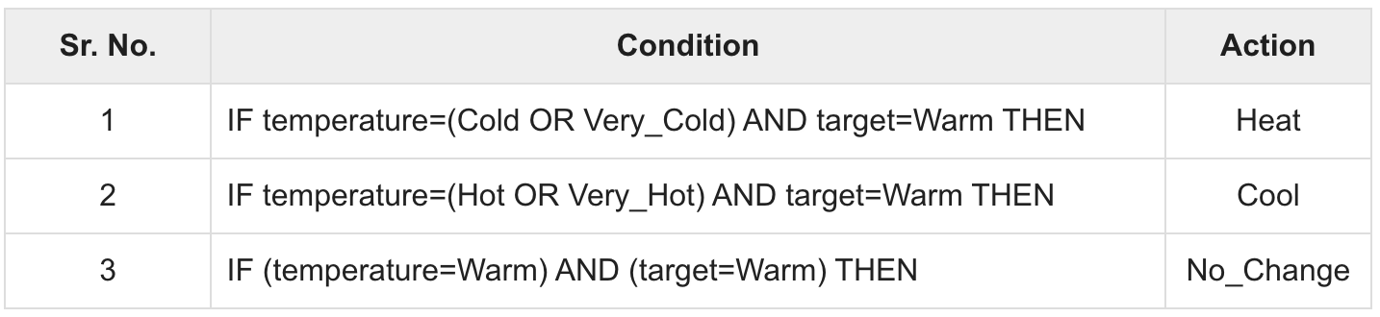
Fuzzy Logic System: Example
Step3 − Construct knowledge base rules
Create a matrix of room temperature values versus target temperature values that an air conditioning system is expected to provide.
Build a set of rules into the knowledge base in the form of IF-THEN-ELSE structures.

Slide 48
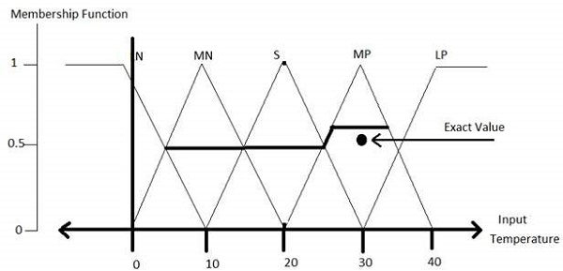
Fuzzy Logic System: Example
Step 4 − Obtain fuzzy value
Fuzzy set operations perform evaluation of rules. The operations used for OR and AND are Max and Min respectively. Combine all results of evaluation to form a final result. This result is a fuzzy value.
Step 5 − Perform defuzzification
Defuzzification is then performed according to membership function for output variable.

Slide 49
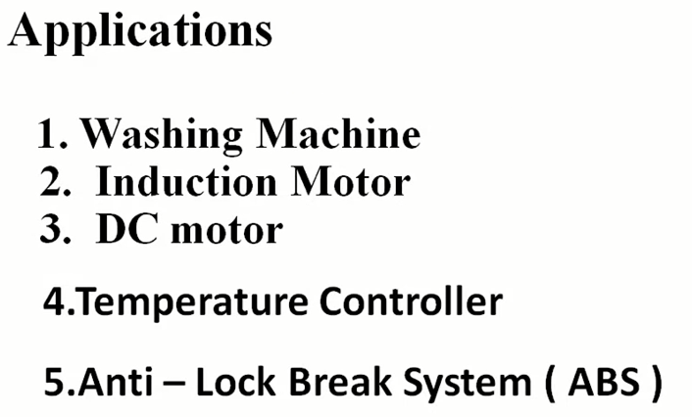

Slide 50
Baye’s Theorem

Slide 51
Baye’s Theorem
Bayes' theorem is also known as Bayes' rule, Bayes' law, or Bayesian reasoning, which determines the probability of an event with uncertain knowledge.
In probability theory, it relates the conditional probability and marginal probabilities of two random events.
Bayes' theorem was named after the British mathematician Thomas Bayes. The Bayesian inference is an application of Bayes' theorem, which is fundamental to Bayesian statistics.
It is a way to calculate the value of P(B|A) with the knowledge of P(A|B).

Slide 52
Bayes' theorem allows updating the probability prediction of an event by observing new information of the real world

Slide 53
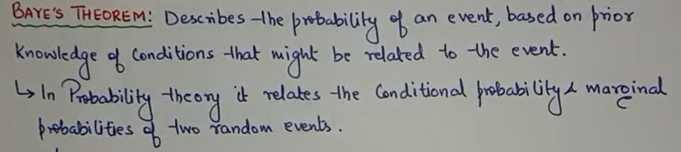

Slide 54
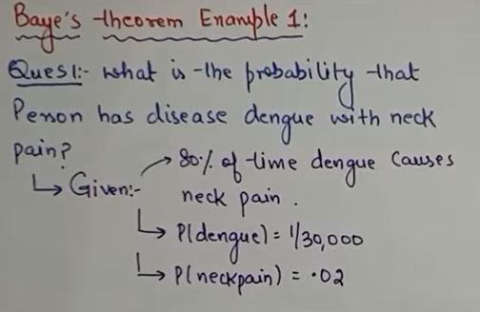

Slide 55
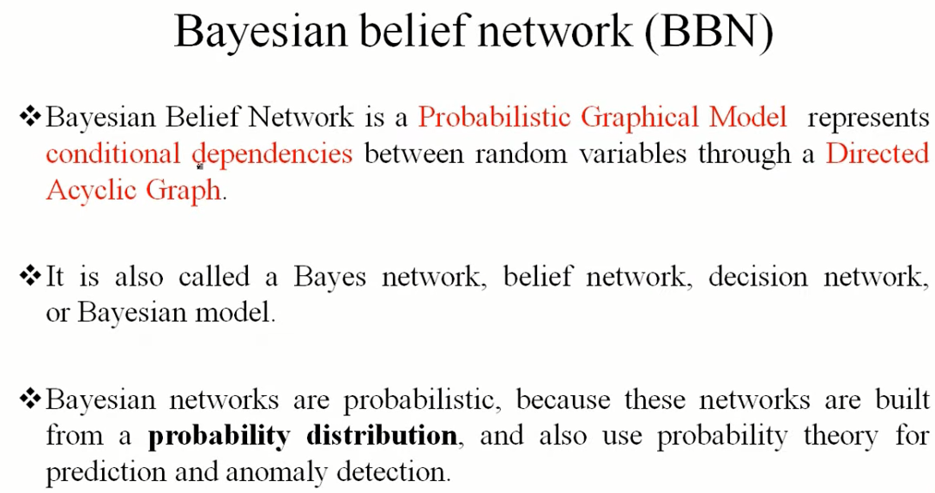

Slide 56
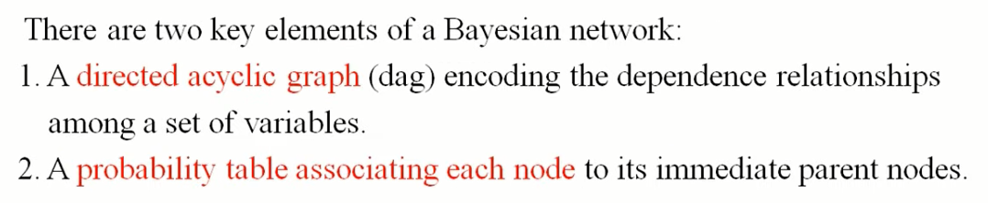
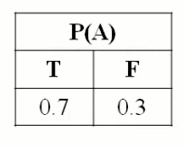
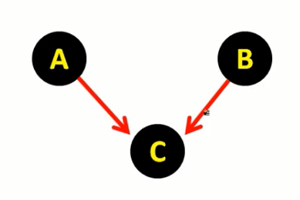
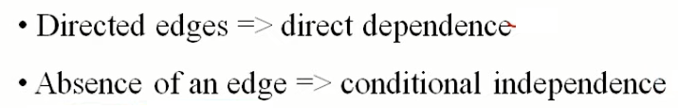


Slide 57
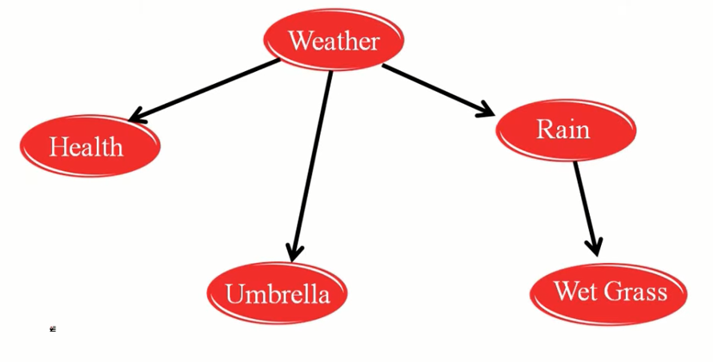

Slide 58
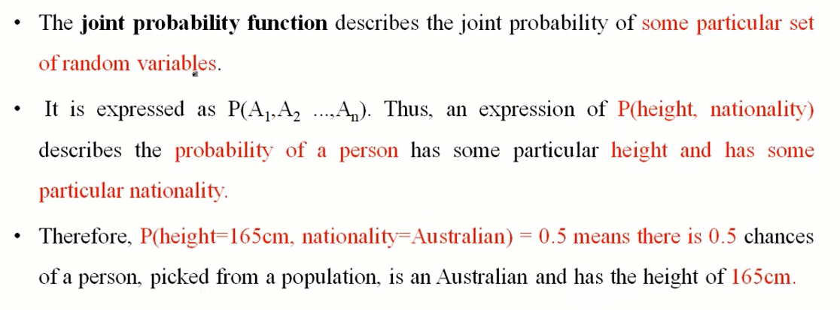

Slide 59
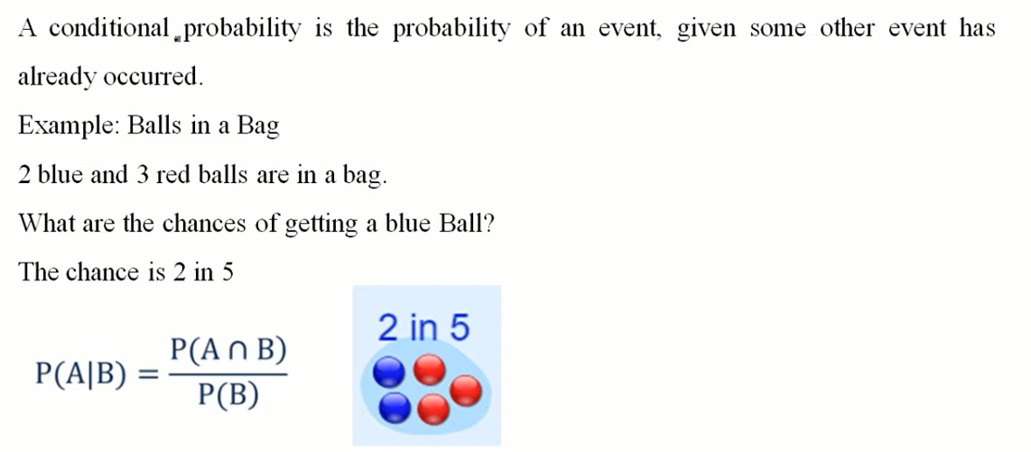
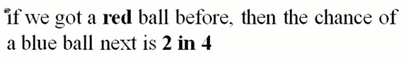
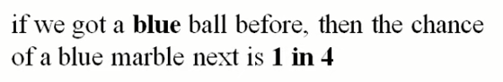

Slide 60
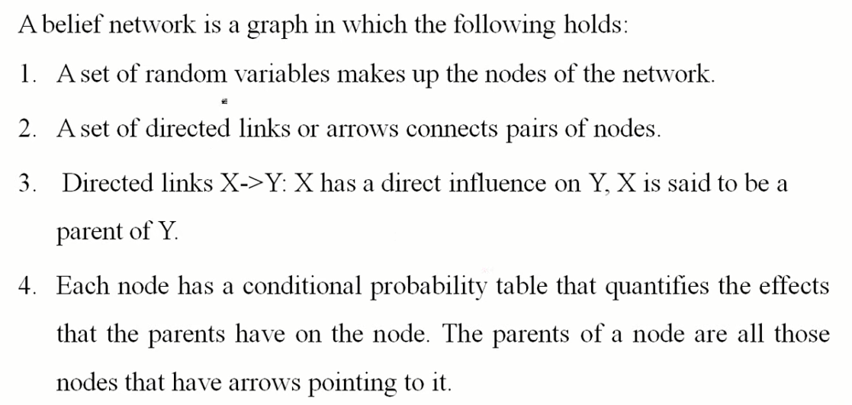
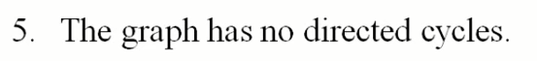

Slide 61
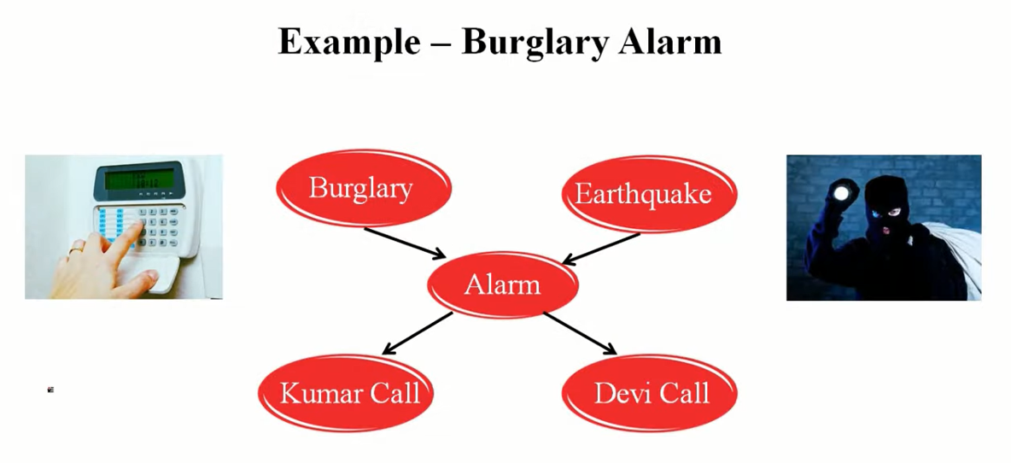

Slide 62
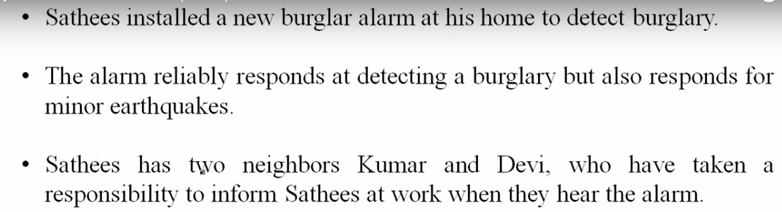

Slide 63
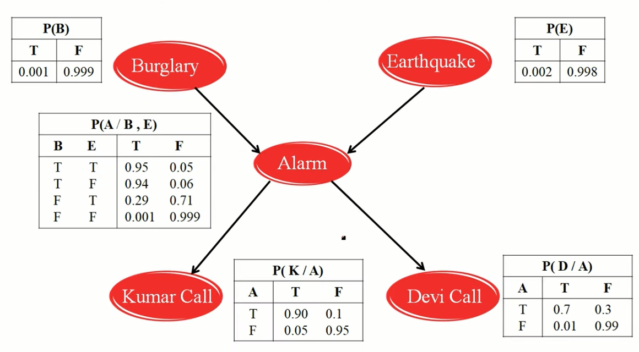

Slide 64
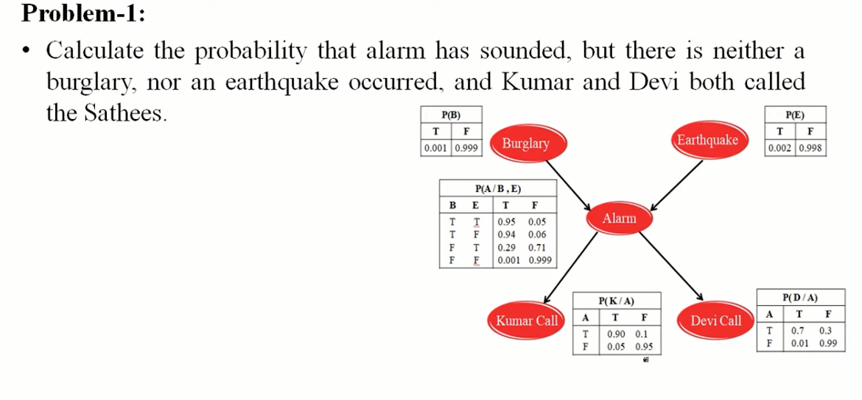

Slide 65


Slide 66


Slide 73
https://www.youtube.com/watch?v=44y6cgQ7cnA
https://www.youtube.com/watch?v=oKko3ukFLVc
https://www.youtube.com/watch?v=P6vHf5StqZA

Slide 74
Thank You

